Slide 1

Multiple Regression

Slide 2
Generalized Linear Model

Slide 3

generalized linear regression
$$y=β_{o}+β_{x}X+ε$$
$β$’s are the coefficients of the relationship between the y and the x
$ε$ represents the error term

Slide 4

Predicted Values
$$\hat{y}=\hat{β_{o}}+\hat{β_{x}}X+\hat{ε}$$
$β$’s are the coefficients of the relationship between the y and the x
$ε$ represents the error term

Slide 5
Different Types of Multiple REgression
 | Continuous DV | Binary DV | Unordered Multicategory DV | Ordered Category DV | Count DV
Continuous IV | OLS Regression | Binary Logistic Regression | Multinomial Logistic Regression | Ordinal Logistic Regression | OLS, Poisson regression
Mixed continuous and categorical IV
Binary/Categorical IV | ANOVA | Log-linear models | Log-linear models |  | Log-linear Models

Slide 6
Example cost of maintenance of an 18-wheeler tractor based on the age of the tractor
Age (years) | $ Cost/6 months
4.5 | 619
4.5 | 1049
4.5 | 1033
4.0 | 495
4.0 | 723
4.0 | 681
5.0 | 890
5.0 | 1522
5.5 | 987
5.0 | 1194
0.5 | 163
0.5 | 182
6.0 | 764
6.0 | 1373
1.0 | 978
1.0 | 466
1.0 | 549

Slide 7
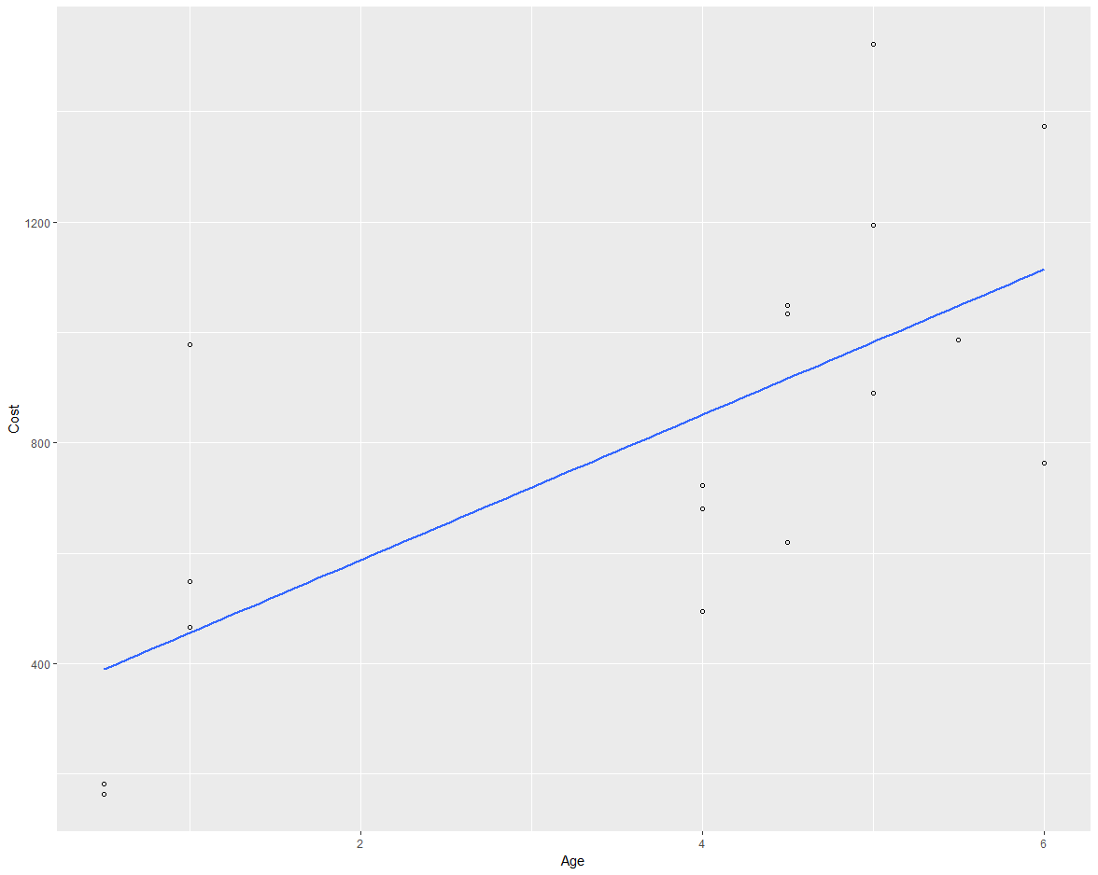
Scatter Plot
The regression line shows the overall trend of an increase in cost with an increase in age. The slope of this relationships is $131.72. This implies that for each unit of time increase in age, the cost goes up by $131.72.

Slide 8
Assumptions of OLS regression
Completeness: All important variables are specified in the model, and the model has no unimportant variables.
Linearity: If a model is known to be nonlinear, such as exponential growth or product life cycles, or if the scatterplot shows an obvious nonlinear pattern, then another model should be used. If the type of model is unknown, a linear model can be assumed since it is the simplest.
Homoskedasticity: The variance around the regression line is the same for all x-values.
Normality of Residuals: While the probability distribution of the variables need not be normal, linear regression assumes that the residuals are normally distributed.
Independent: We assume that the observations are independent of each other.

Slide 9
Cleaning Data

Slide 10
Types of Data Cleaning
Removing extreme data points (outliers)
Removing missing data
Transforming the data

Slide 11
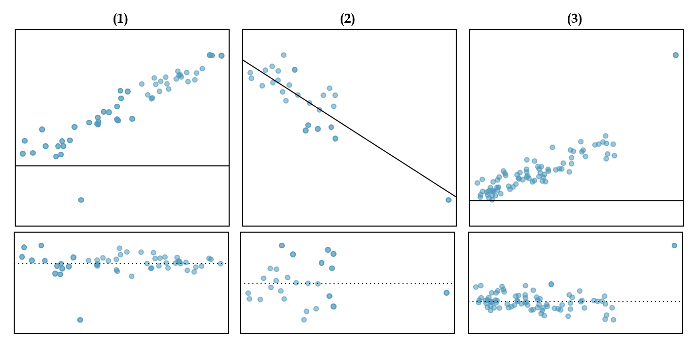
OUtliers

Slide 12
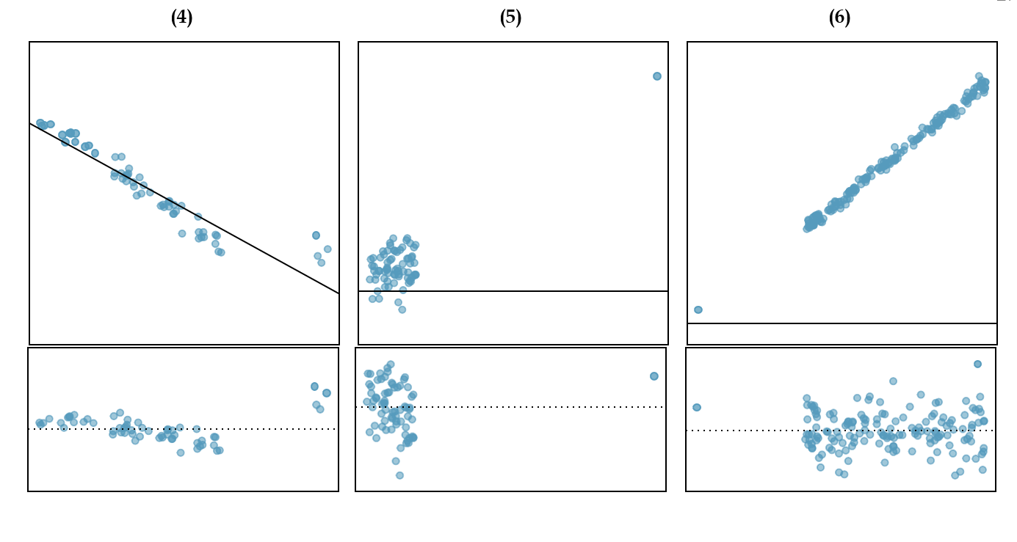
OUtliers

Slide 13
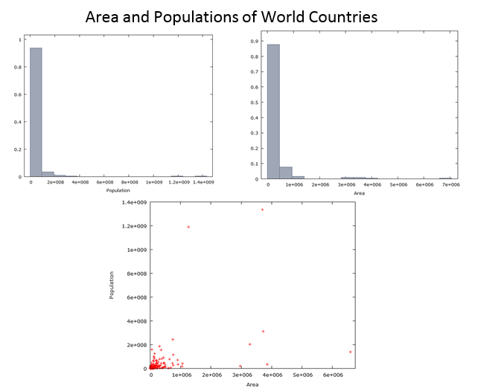
Data Transformation – Pre Log

Slide 14
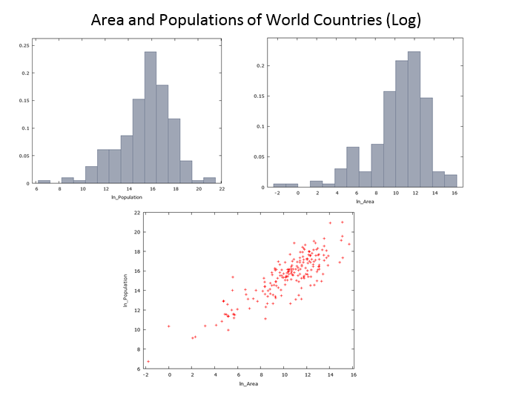
Data Transformation – Post Log

Slide 15
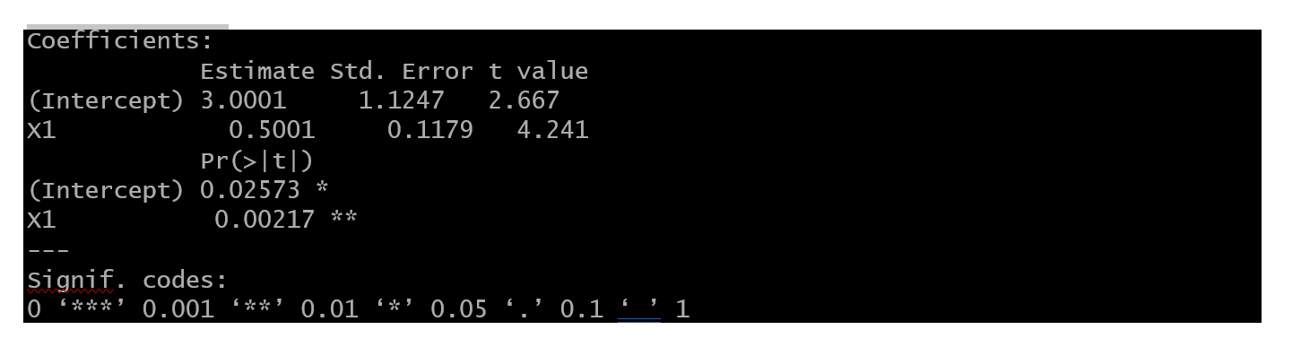
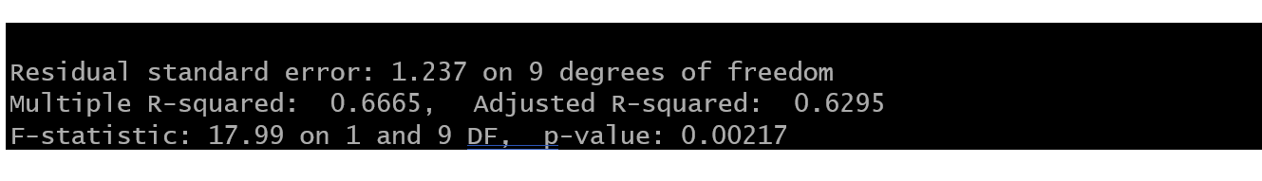
Anscombe’s Quartet
Y = 3.001 + .5001X1

Slide 16
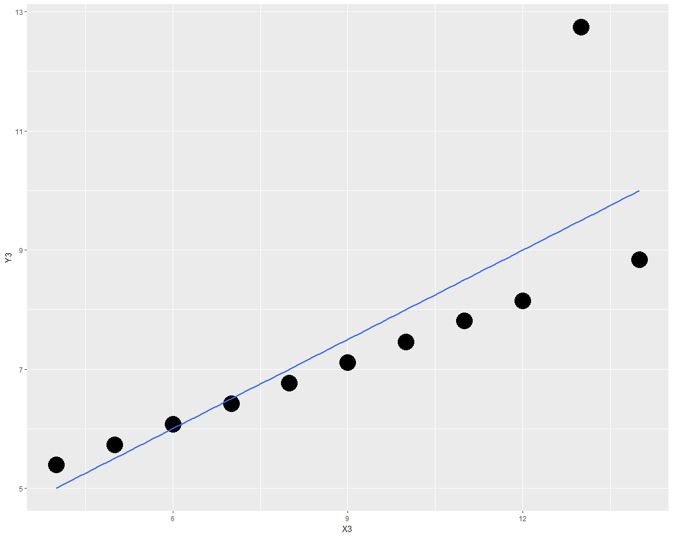
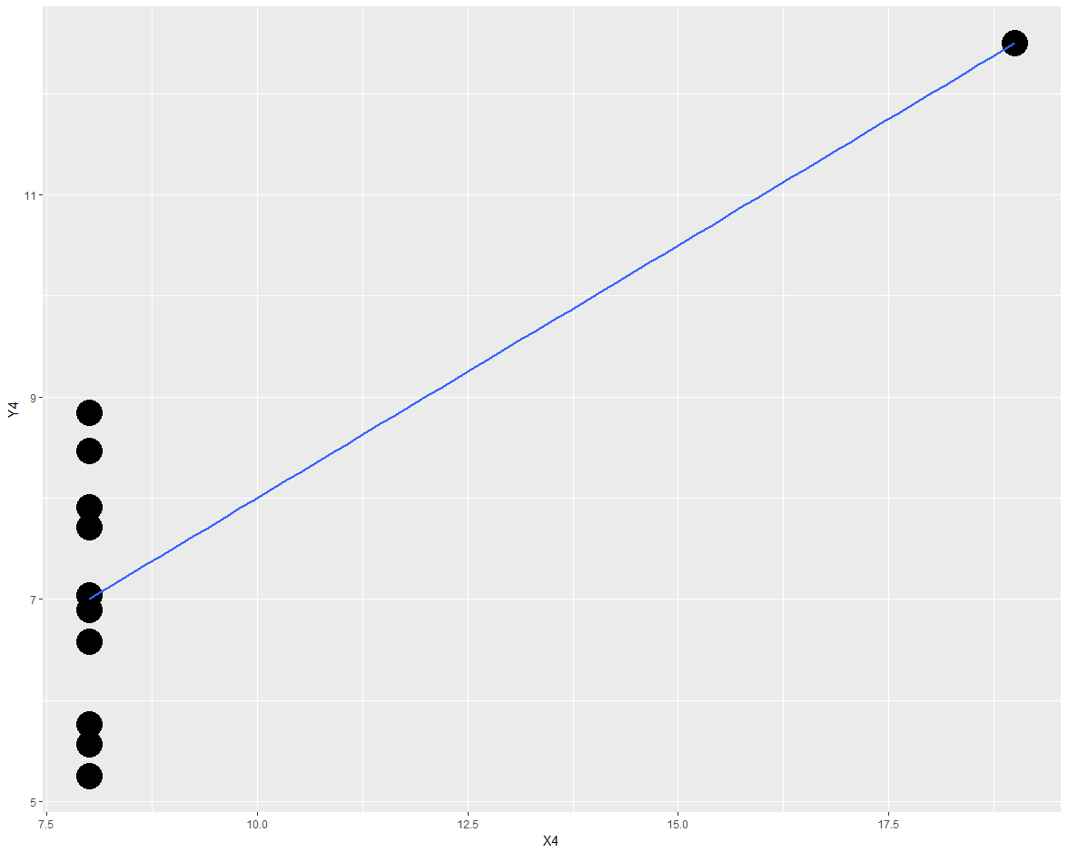
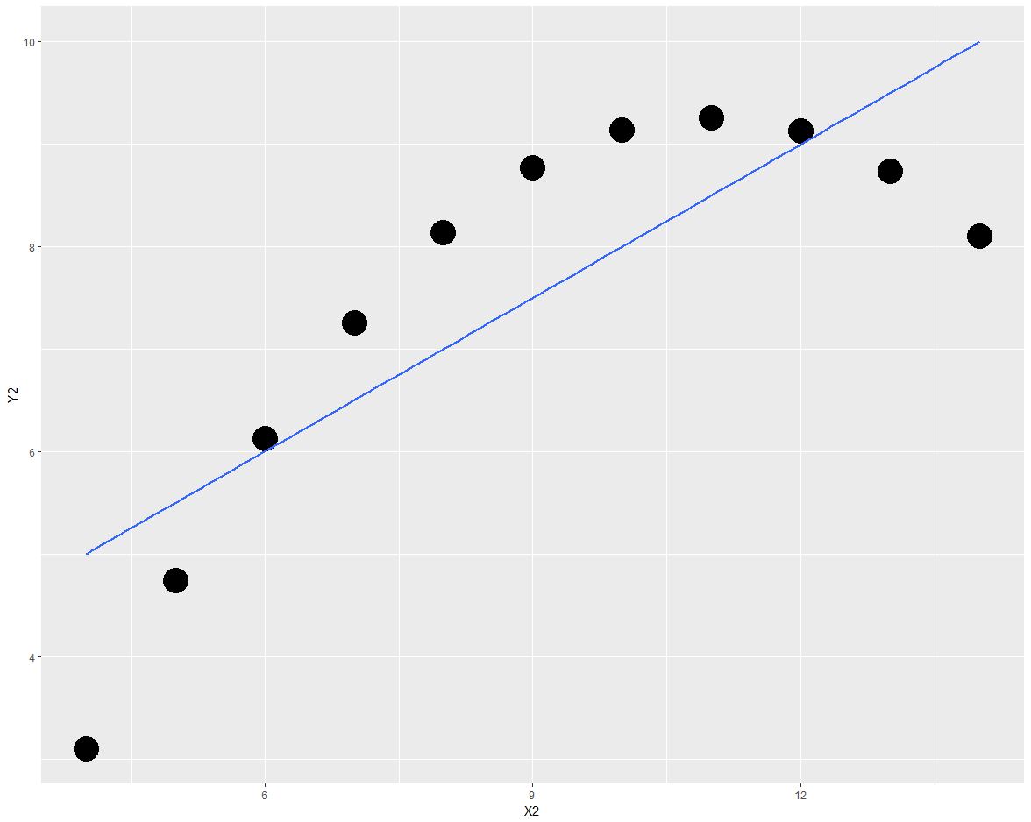
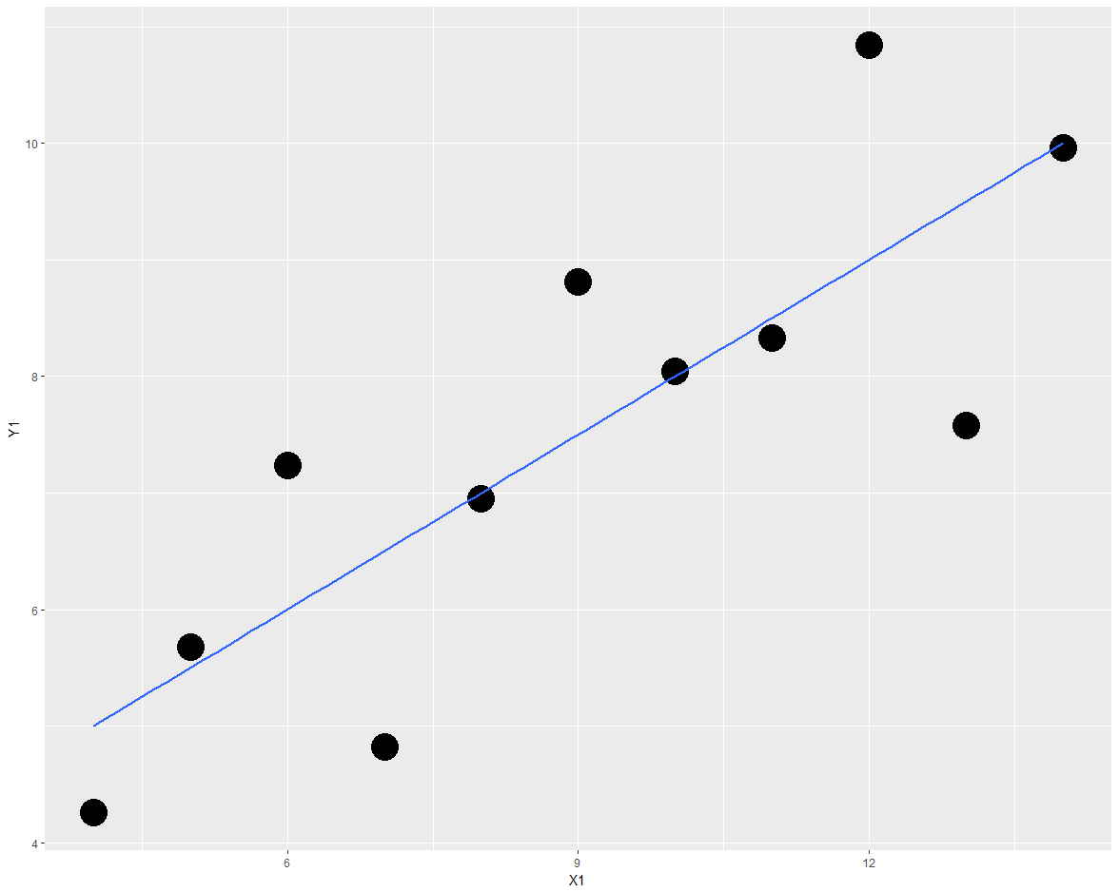
Anscombe’s Quartet
Anscombe created his data sets to demonstrate that the numerical results of a linear regression should always be considered along with a scatterplot of the data.

Slide 17
Regression Modeling
Hypothesize the form of the model. It is a linear model or nonlinear? Using graphical tools, like a scatterplot, can help with this. With multiple explanatory variables, this can get complicated, so while the graphical representation is still an important step, you might want to assume a linear model, until the data shows otherwise.
Collect the sample data. While people usually collect the data, and then hypothesize the model, collecting the data after laying out your conceptual model can help to ensure that you don’t leave out important explanatory variables. It can also ensure that you are as unbiased as possible in your data collection. More commonly, however, the data is already available, and so you skip this step.
Use the sample data to estimate the parameters in the model. This is also known as “performing regression analysis”. The exact details of this step are dependent on the type of regression you are using.
Statistically check the fit and accuracy of the model. This is where post-regression analysis is used, including hypothesis testing on coefficients, models, and checking goodness of fit.
Use the model to make predictions. A common method is to build a model using a subset of data, and then predict using the remainder of the data. This allows you to be more confident in your predictive results.

Slide 18
Graphical TOols
Scatterplots - Scatterplots show many points plotted in the Cartesian plane
Boxplots – A method of graphically depicting groups of numerical data through their quartiles
Possibilities for whiskers:
the minimum and maximum of all of the data
the lowest datum still within 1.5 IQR of the lower quartile, and the highest datum still within 1.5 IQR of the upper quartile (often called the Tukey boxplot)
one standard deviation above and below the mean of the data
the 9th percentile and the 91st percentile
the 2nd percentile and the 98th percentile.
QQ Plots - graphical technique for determining if two data sets come from populations with a common distribution
Histogram - estimate of the probability distribution of a continuous variable

Slide 19
Summary Statistics
Minimum
1st quartile
Median
Mean
3rd quartile
Maximum
Variance
Standard Deviation
Correlation Coefficient Matrix

Slide 20
Model Testing

Slide 21
R²
Coefficient of determination.
Gives an overall picture of how much of the variance in the dependent variable is related to inclusion of the explanatory variables in the model.
An R² of 1 means all of the variance is predicted by the variables you include, while an R² of 0 implies none of the variables, including the constant, predict the dependent variable.
You will rarely see one of these extremes, but it is good to know what they stand for. In OLS regression.
R² is also called the “goodness of fit”.

Slide 22
Adjusted R²
Adjusted R2 should always be used for a multiple regression and for comparing various types of regression.

Slide 23
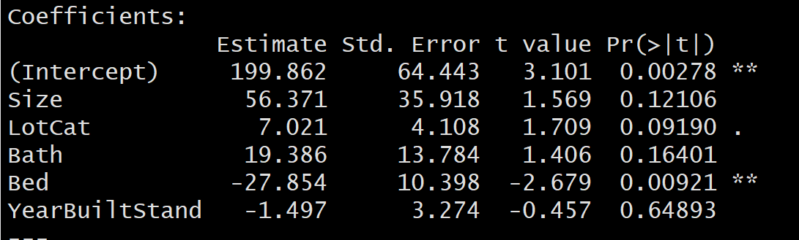
T-test
H₀: β_{x} = 0
H_{A}: β_{x} ≠ 0

Slide 24
F-test
H₀: β₁ = β₂= β₃ =… =β_{n}=0
H_{A}: At least one β_{j} ≠ 0

Slide 25
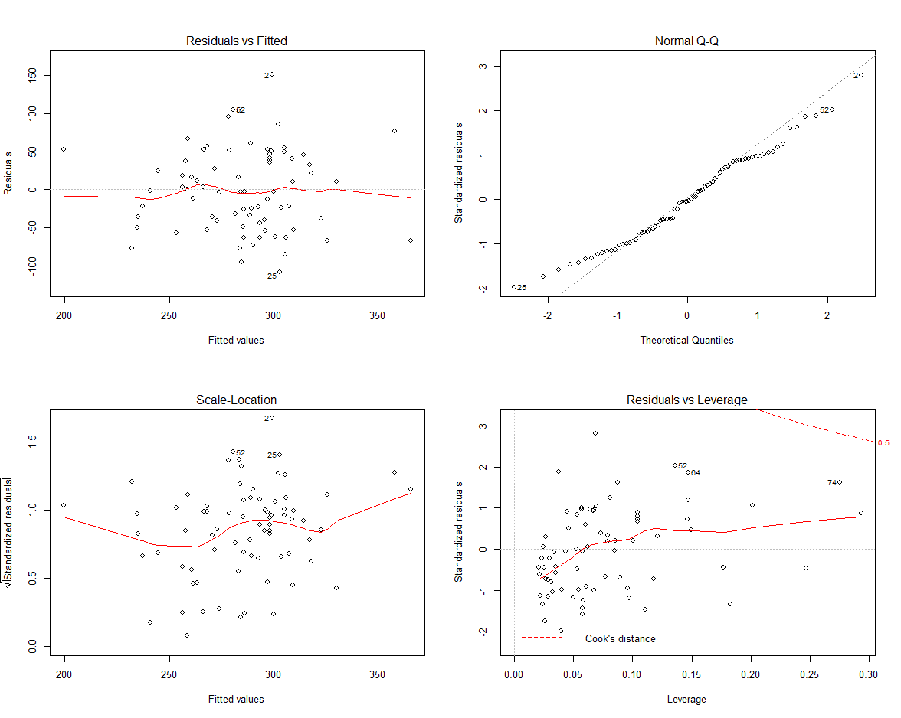
Residual Plots Resdiual vs Fitted
The first plot shows error Residuals vs Fitted values.
The dotted line at y=0 indicates our fit line.
Any point on fit line obviously has zero residual. Points above have positive residuals and points below have negative residuals.
The red line is the smoothed high order polynomial curve to give us an idea of pattern of residual movement.
In our case we can see that our residuals have curved pattern. This could mean that we may get a better model is we try a model with a quadratic term included. We will explore this point further by actually trying this to see if it helps.

Slide 26
Residual Plots - Normal Q-Q
The Normal Q-Q plot is used to check if our residuals follow Normal distribution or not.
The residuals are normally distributed if the points follow the dotted line closely
In this case residual points follow the dotted line closely except for observation #22
So our model residuals have passed the test of Normality.

Slide 27
Residual Plots Scale vs Location
Scale location plot indicates spread of points across predicted values range.
One of the assumptions for Regression is Homoscedasticity . i.e variance should be reasonably equal across the predictor range.
A horizontal red line is ideal and would indicate that residuals have uniform variance across the range.
As residuals spread wider from each other the red spread line goes up.
In our case till approx 100000 or data is Homoscedastic i.e has uniform variance and later it becomes Heteroscedastic.

Slide 28
Influence versus Leverage
Influence : The Influence of an observation can be thought of in terms of how much the predicted scores would change if the observation is excluded. Cook’s Distance is a pretty good measure of influence of an observation.
Leverage : The leverage of an observation is based on how much the observation’s value on the predictor variable differs from the mean of the predictor variable. The more the leverage of an observation, the greater potential that point has in terms of influence

Slide 29
Residual Plots Residuals VS LEverage
In this plot the dotted red lines are cook’s distance and the areas of interest for us are the ones outside dotted line on top right corner or bottom right corner. If any point falls in that region , we say that the observation has high leverage or potential for influencing our model is higher if we exclude that point.
Its not always the case though that all outliers will have high leverage or vice versa.

